Slide 1
Thermodynamics
Ch7 : Entropy
6. Principle of Entropy Increase

Slide 2
Principle of Entropy Increase
For an isolated system, Q = 0
ΔS = ΔS_{irrev} ≥ 0
Q_{h}
W
T
Uniform
Q_{c}
Heat
Take the whole univers :
Isolated System (?)
?
Thermal death (?)

Slide 3
Implications of First Law
Conservation of Energy
Energy can be neither created nor destroyed: It can only be transformed
Conservation of Mass
Mass can be neither created nor destroyed: It can only be transformed
Special relativity
E=mc²
The material world is unified
NB: There is no conservation law for ideas

Slide 4
Is the universe an isolated system?
The whole
Material
World
(Planets …
Galaxies …)
The whole
Immaterial
World
(Ideas …
Passions …)
Is this an isolated system?
Is this an isolated system?
Small numbers: does not apply
Second Law only applies statistically
Large numbers: applies
huge numbers: ?? Exceptions ??

Slide 5



Entropy and information theory
In information theory (Shanon 1948):
Entropy of information = ln(min number of bits to describe it)
Information degradation for each transfer
…
Application to the study of big data
Maxwell’s demon
A
B
Maxwell has imagined a demon who:
Allows of passing towards A
Allows of passing towards B
Refuses all other movements
Mixing is not irreversible?

Slide 6

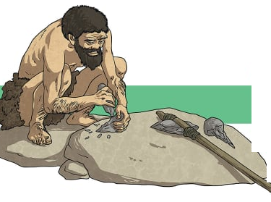



Is the world in evolution or in decay?
Better ?
Worse ?

Slide 7
Summary
Principle of entropy increase
Entropy of an isolated material system always increases
Does this lead to thermal death?
First Law + relativity + conservation of mass ⇒ Material world is unified
Is the whole world (material & immaterial) an isolated system?
Is the whole world is in evolution or in decay?

