Slide 1
Thermodynamics
Ch7 : Entropy
8. Entropy from Statistical Thermodynamics

Slide 2
Statistical introduction: Micro & Macro states
Macro - state
Micro - states
Distribution assuming
indistinguishable objects
Distribution assuming
distinguishable objects
a
c
b
c
..
..
1
3
b
a
..
d
d
..
Different Positions,
Different energy levels
…
a
c
a
b
..
..
2
2
b
d
c
d
..
..
Major Assumptions:
The distribution of molecules is totally random
All micro-states are equally probable

Slide 3
Thermodynamic probability W
The thermodynamic probability W of a macro state
= Number of corresponding micro states
Box 1
Box 2
Box J
A given
Macro state
N₁
N₂
N_{J}
…
To get corresponding Micro state:
Number of arrangements of N distinguishable molecules : N!
Number of arrangements of N_{j} distinguishable molecules in box j: N_{j}!

Slide 4
Distribution between 2 boxes
Macro state
N_{A} - N_{B}
Micro states
W
N_{A}
N_{B}
0 - 4
1,2,3,4
1
1 - 3
1
2,3,4
2
1,3,4
3
1,2,4
4
1,2,3
4
2 - 2
1,2
3,4
1,3
2,4
1,4
2,3
3,4
1,2
2,4
1,3
2,3
1,4
6
3 - 1
2,3,4
1
1,3,4
2
1,2,4
3
1,2,3
4
4
4 - 0
1,2,3,4
1
For large N use
Sterling formula:
ln N! ≈ N ln N - N

Slide 5
Entropy starting from statistics
The distribution of molecules is totally random
All micro-states are equally probable
The macro-state of W max is the most probable
An isolated system tends spontaneously towards the state of W max
Another formulation of Second Law (direction of a process):
An isolated system spontaneously tends towards W max
S = f (W)

Slide 6
Relation between entropy S and probability W
System A
System B
?
S = f (W)
S_{A} , W_{A}
S_{B} , W_{B}
System C
S_{C} = S_{A} + S_{B}
S_{C} = S_{A} + S_{B}
W_{C} = W_{A} . W_{B}
f(W_{A} W_{B}) = f (W_{A}) + f (W_{B})
∂ /∂W_{A}
W_{B} f '(W_{A} W_{B}) = f '(W_{A})
∂ /∂W_{B}
W_{A}W_{B} f ''(W_{A} W_{B}) + f '(W_{A}W_{B}) = 0
W f''(W) + f'(W) = 0
S = f (W) = C₁ ln (W) + C₂
S = C₁ ln (W)
Put: S = 0 for W=1

Slide 7
Obtaining the coefficient
Irreversible
Process
Reversible
Process
Quantity of gas = 2 mol
= 2 N_{A} molecules
State 1
gas
void
gas
void
Q
W
State 2
Q = W
W₁=1
C₁= /N_{A} = k
S=k ln W

Slide 8
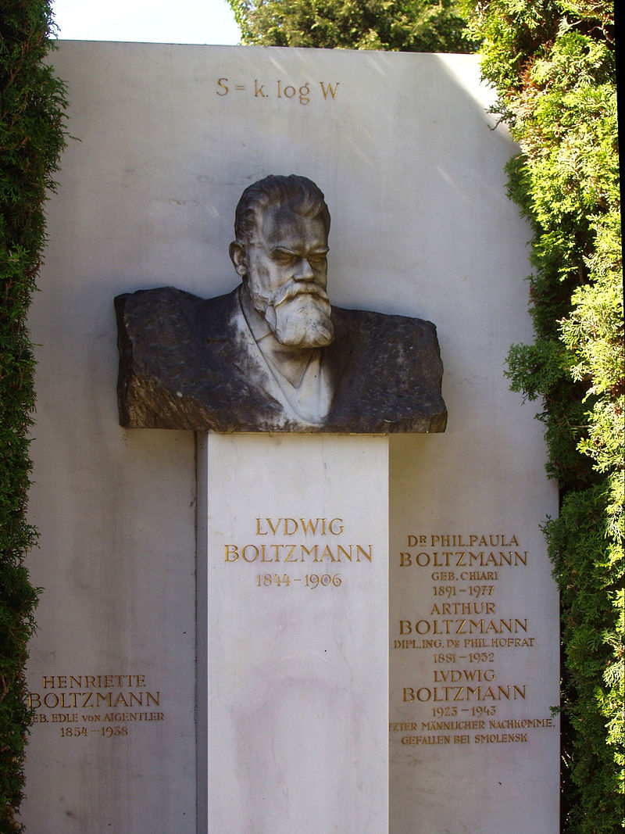

Slide 9
Summary
Entropy from statistical thermodynamics
Macro states, microstates and Thermodynamic probability W
An isolated system tends spontaneously towards the state of W_{max}
Entropy S = f (W)
Use S and W properties
+ free expansion:
Entropy S = k ln(W)
Entropy is another way to say Thermodynamic Probability

