Slide 1
Thermodynamics
Ch7 : Entropy
5. Charts Based on Entropy

Slide 2

T- s, h - s Charts
P
For an ideal gas:
w +
w_{f}
For v = constant:
v
For P = constant:
T
T or h
s =const
v =const
P =const
q +
∫Tds_{irrev}
s
T =const
Reject heat
Add heat
s
T ds = q dt + T ds _{irrev}

Slide 3
T - s, h - s charts (next)
Region of wet vapor
NB:
T ds = dh – v dP
⇒ ∂h / ∂s |_{P const} = T
P = cont ⇒ T = const
h
v₁
T
T₁
C.P.
v₁
P₂
C.P.
P₂
P₁
P₁
s
s

Slide 4
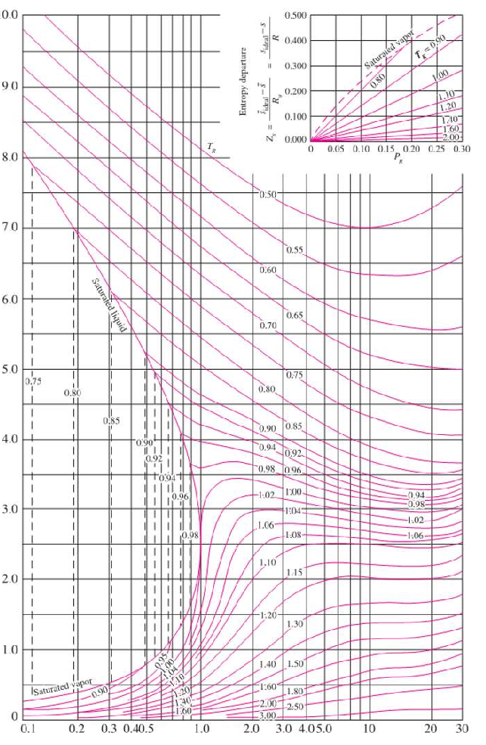
Compressibility chart for entropy departure
Correction:
Reduced temperature Tr
Where:
s* is (semi)ideal entropy
s is real entropy
R is specific gas constant
Reduced pressure Pr

Slide 5
Summary
Charts Based on Entropy
Area under a curve in T-s = q + ∫ Tds_{irrev}
T
C.P.
v₁
P₂
P₁
(s*-s)/R
s
h
v₁
Tr
T₁
C.P.
P₂
P₁
s
Pr

