Slide 1
Thermodynamics
Ch. 1 : Introduction
Prof Mohamed Nabil Sabry

Slide 2
Why Thermodynamics?
Science of energy transfer and conversion
Life is nothing but: exchanges or transformations!
Material
Im – Material
Knowledge
Feelings …
Mass
Charge
Force
…
Energy
Energy is not only
calorific or mechanical!

Slide 3
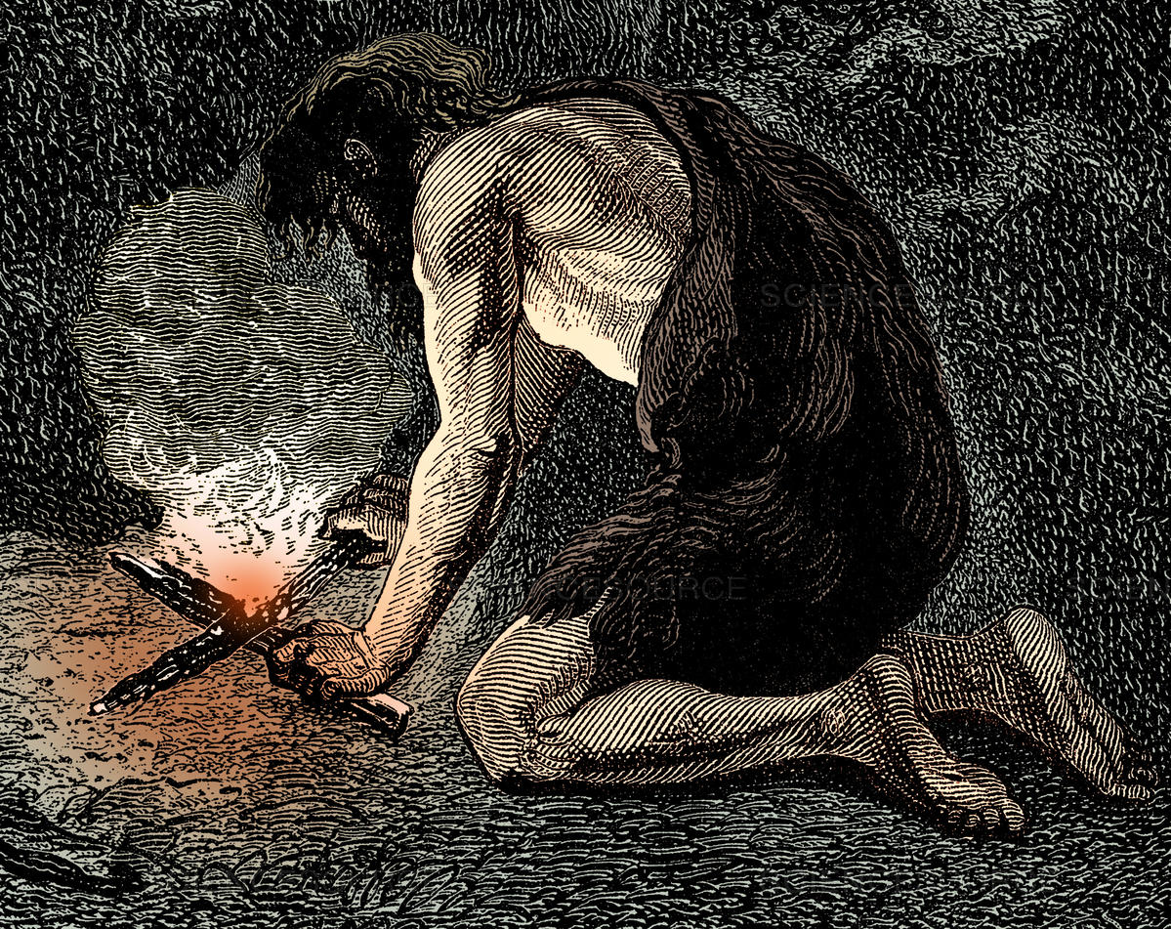
History of Energy
Pre-Industrial
Industrial
New
Energies
Geothermal,
Biomass,
Waves, …

Slide 4
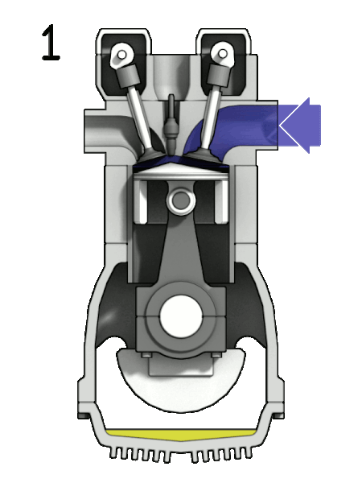
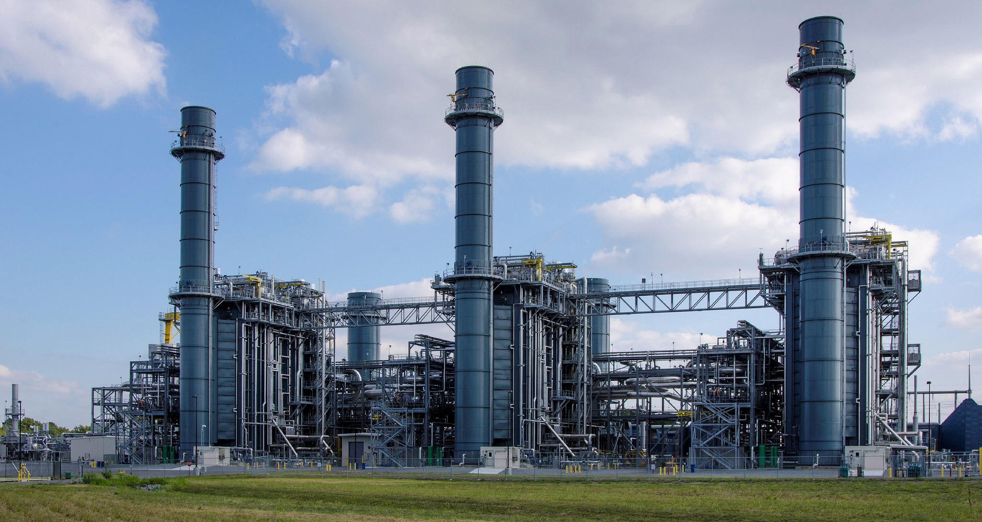


Place of thermodynamics academically
Basic Sciences
Basic Engineering Sciences
Math – Physics
Mechanics – Chemistry
Thermodynamics
Heat and mass transfer – Fluid mechanics
…
Physics of semi-conductors
Applied Engineering Sciences
Refrigeration
& Air Conditioning
Power plants
Internal
Combustion
Engines
Chemical industries …

Slide 5
Summary
Life depends on energy
Human development is related to energy
Energy crisis – environmental impact:
⇒ Renewable energies
Applications of thermodynamics are endless

